Slide 1












Data Visualization with Python
Data Visualization with Python

Slide 2


What is Data Visualization?
Data visualization is the representation of data through use of common graphics, such as charts, plots, infographics and even animations. These visual displays of information communicate complex data relationships and data-driven insights in a way that is easy to understand.

Slide 3
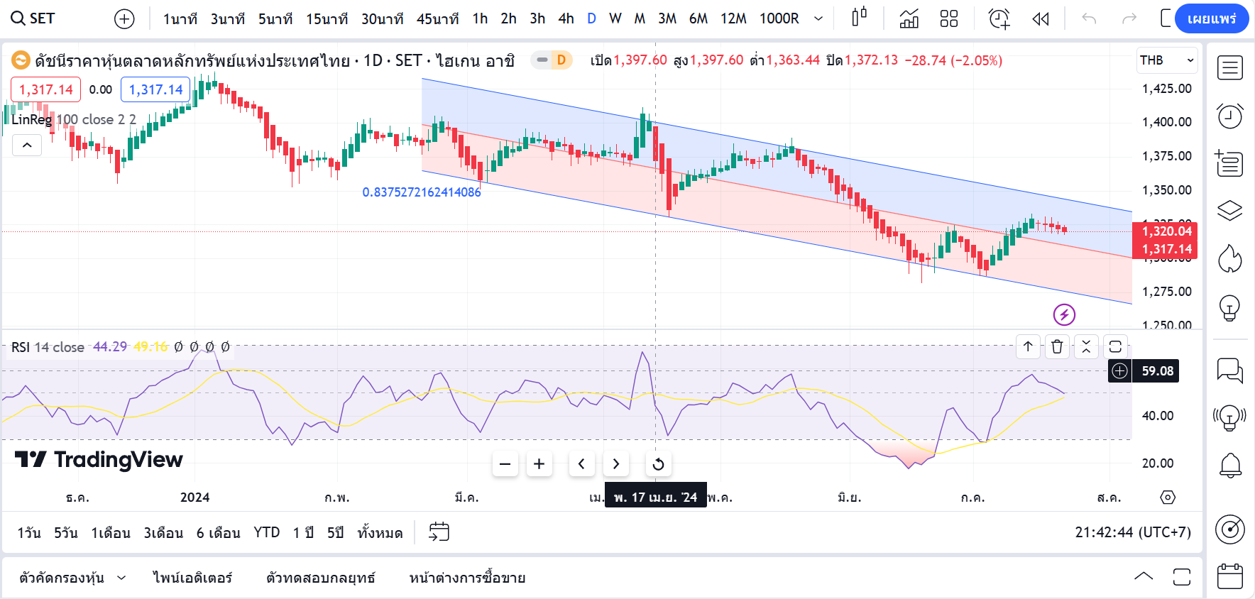

Slide 4
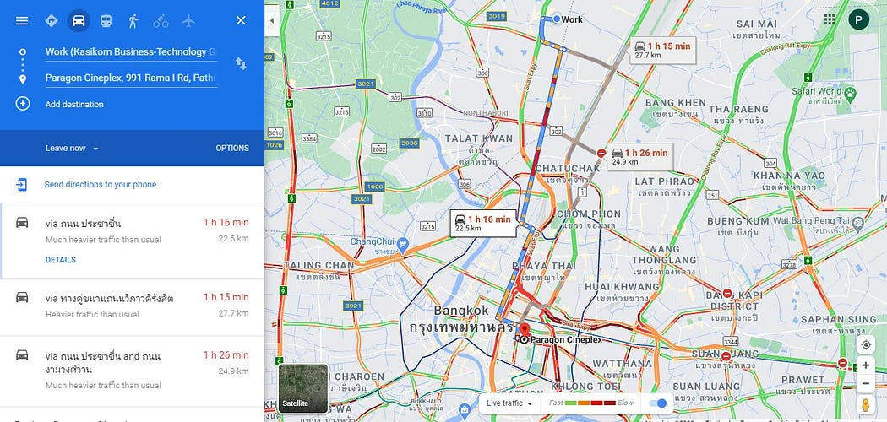

Slide 5
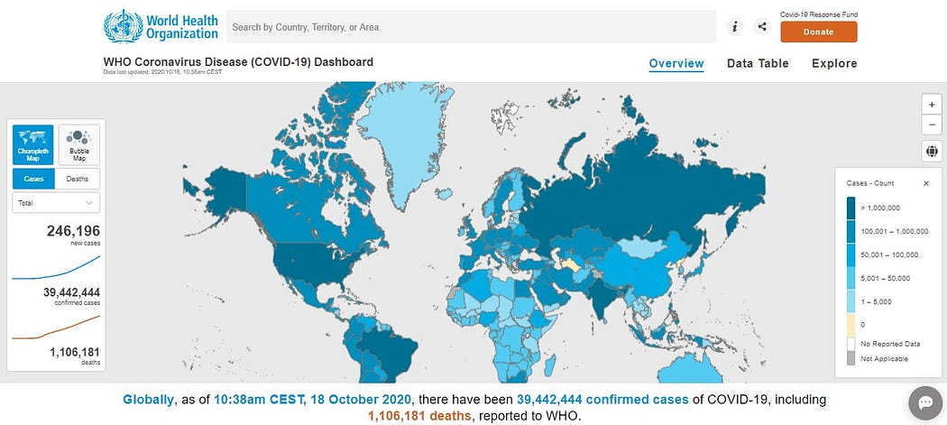

Slide 6
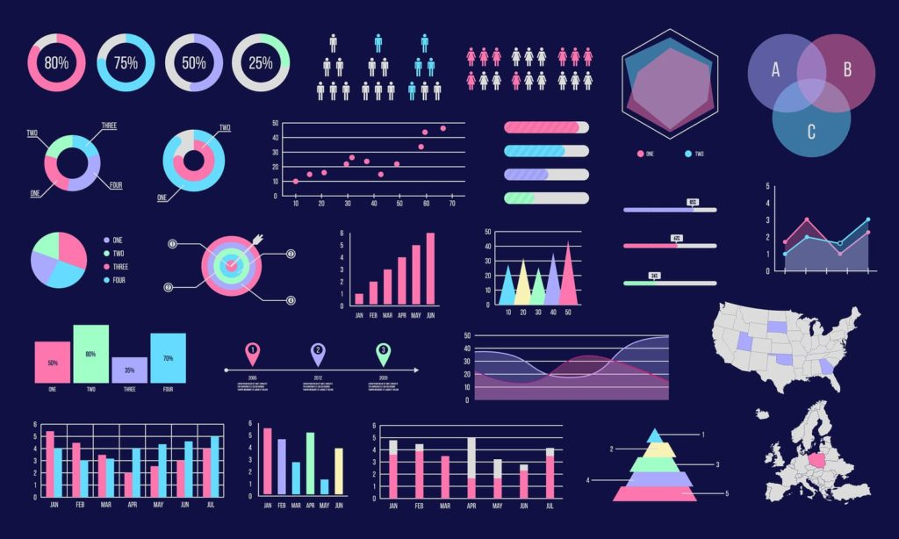

Slide 7

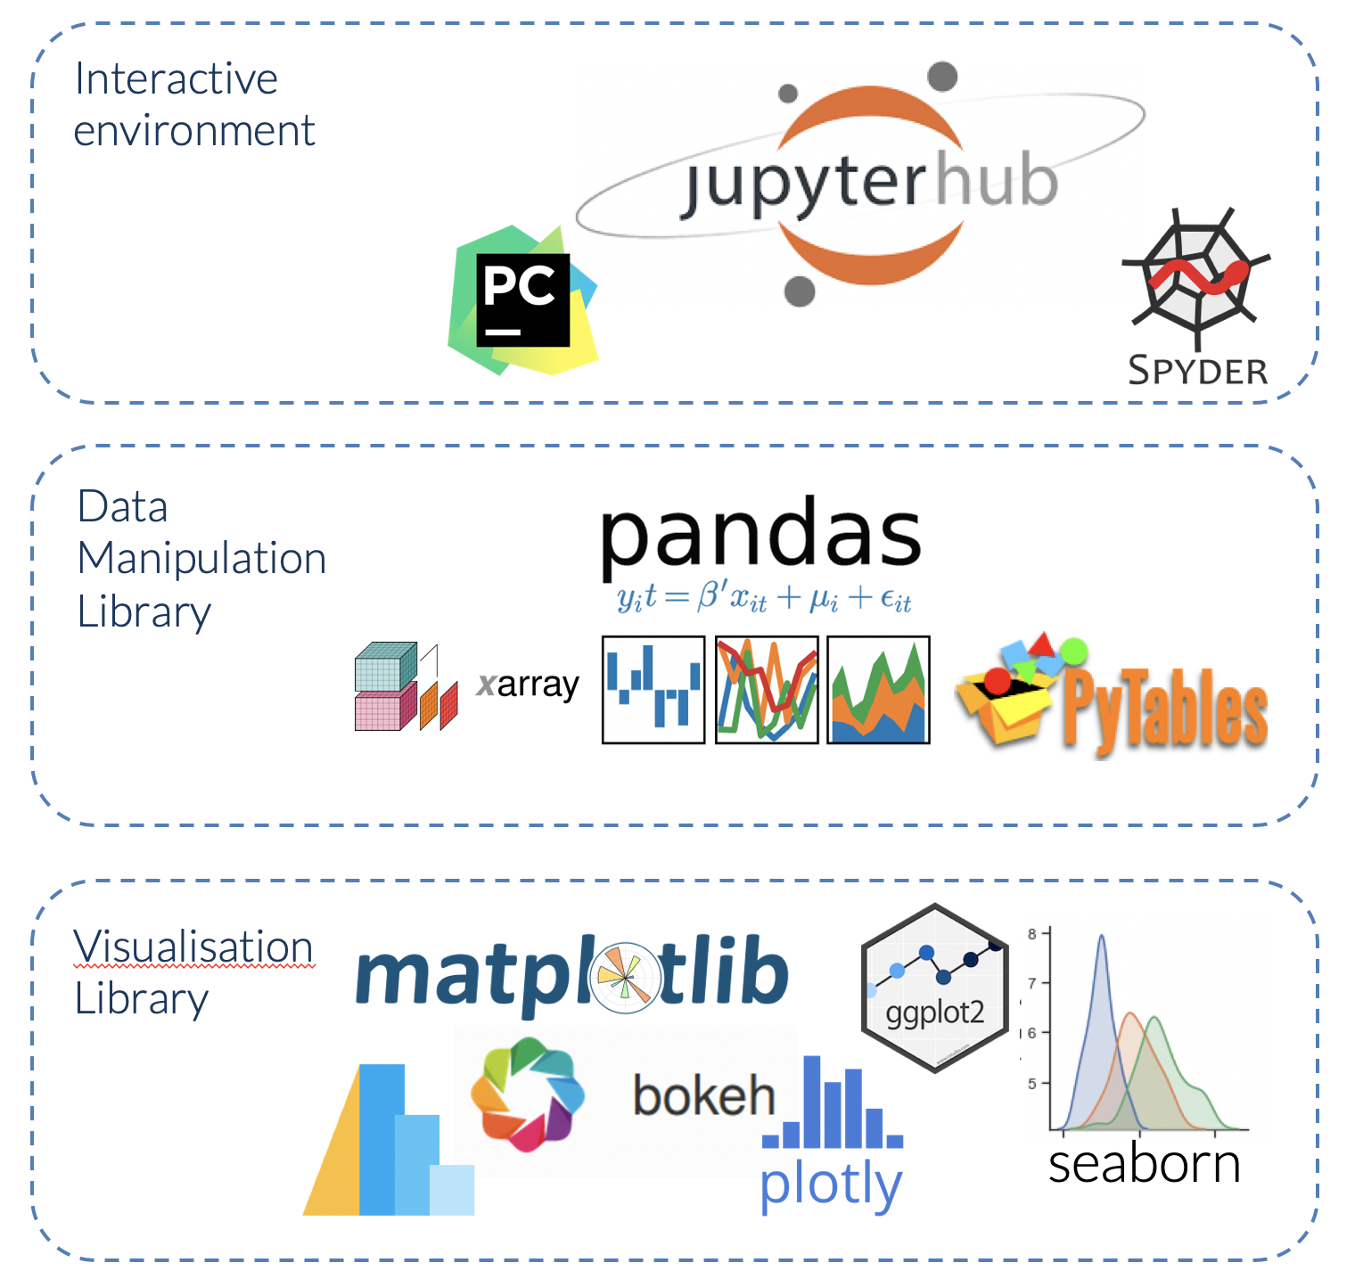
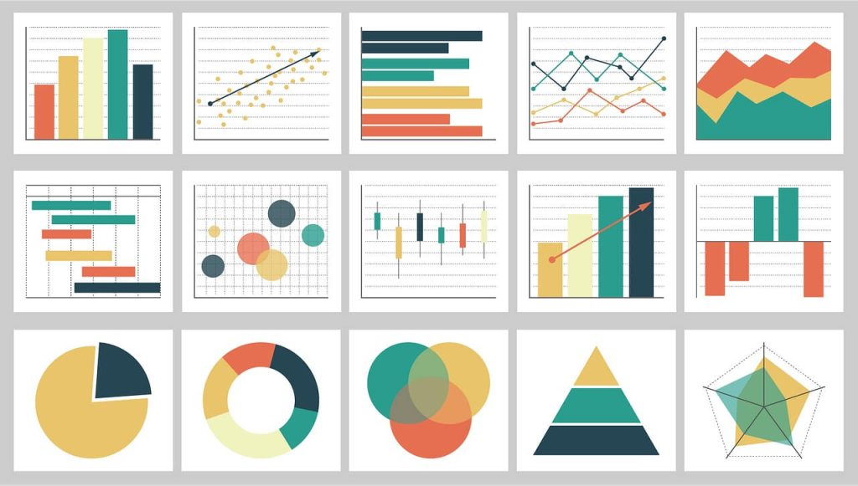
Why Use Python for Data Visualization?

Slide 8

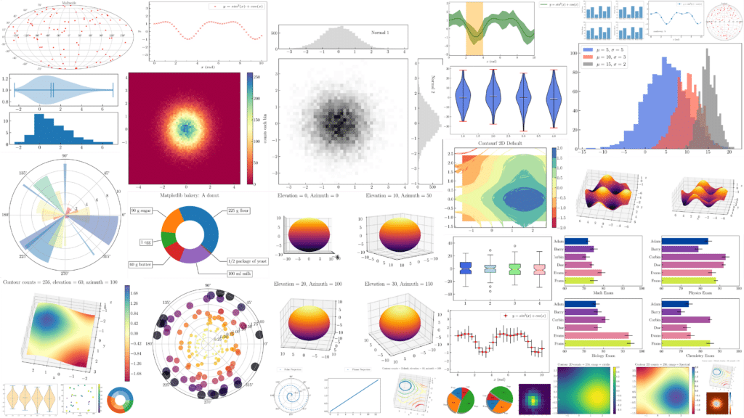

Slide 9
THANK YOU
FOR ATTENTIONS

